Slide 1

Monash Undergraduate Research Projects Abroad (MURPA)
David Abramson
Monash e-Science and Grid Engineering Lab (MESSAGE Lab)
Faculty of Information Technology
Associate Director: Monash e-Research Centre
ARC Professorial Fellow

Slide 2
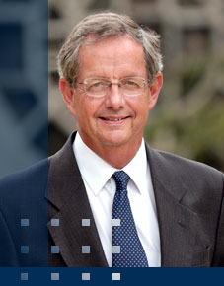
International Engagement
“As we look into the 21st century, the students who will be graduating more and more will be spending their careers in a world where national boundaries will be less and less important.”
Vice-Chancellor and President, Professor Richard Larkins AO

Slide 3
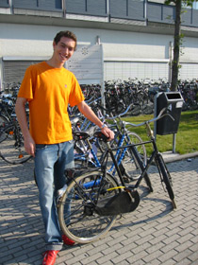
Study Abroad
Many opportunities to spend one or two semesters overseas as part of a Monash degree.
  more than 115 exchange partner universities in 25 different countries
Incentives for exchange to our own campuses
  Malaysia & South Africa
"I found potential employers very willing to discuss my experiences gained whilst overseas on exchange. With so many global organisations, companies are always looking for people who can demonstrate that they can survive in this wide world. It gives you, and your CV, a great advantage...trust me!" David Feld -- Tilburg University, The Netherlands

Slide 4
Why do MURPA?
Facilitate an international research experience for Monash undergraduate students.
Enable Monash undergraduate students to experience living in a different cultural environment.
Encourage undergraduate students to complement their coursework with real cutting-edge research in world leading laboratories.
Improve the employability and reputation of graduates and Monash University.

Slide 5
What is MURPA?
The proposal augments existing opportunities currently offered by Monash Abroad by supporting:
  A new research oriented ‘summer mode’ undergraduate subject that allows students to complete a research project abroad;
  Collaborative research between Monash academics and peers overseas;
  A video conference based seminar stream that imports real time presentations from leading international researchers;
  Initial target will be UCSD, but will expand to more or PRAGMA partners over time.

Slide 6
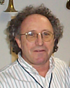

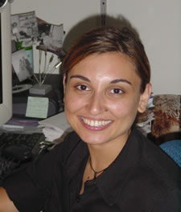
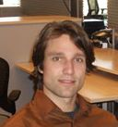
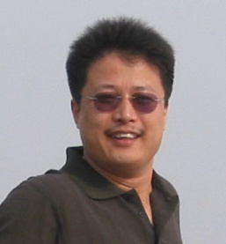
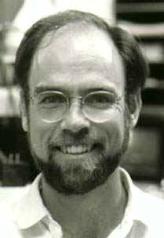
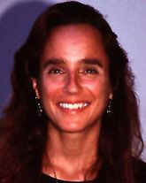
MURPA International Research Seminar Series 2008
Integrating Neuroscience Knowledge: Brain Research in the Digital Age, Mark Ellisman, 24Jul08
CAMERA: Community Cyberinfrastructure for Advanced Microbial Ecology Research and Analysis Larry Smarr, 31 Jul08
On Accelerating Scientific Discovery using Scientific Workflows and the Kepler System, Ilkay Altintas, 7Aug08
Visualization, Jurgen Schulze, 21Aug08
Avian Flu Modeling, Wilfred Li, 28Aug08
Cardiac modeling, Andrew McCulloch, 4Sept08
Quantum Chemistry, Kim Baldridge, 11Sept08

Slide 7
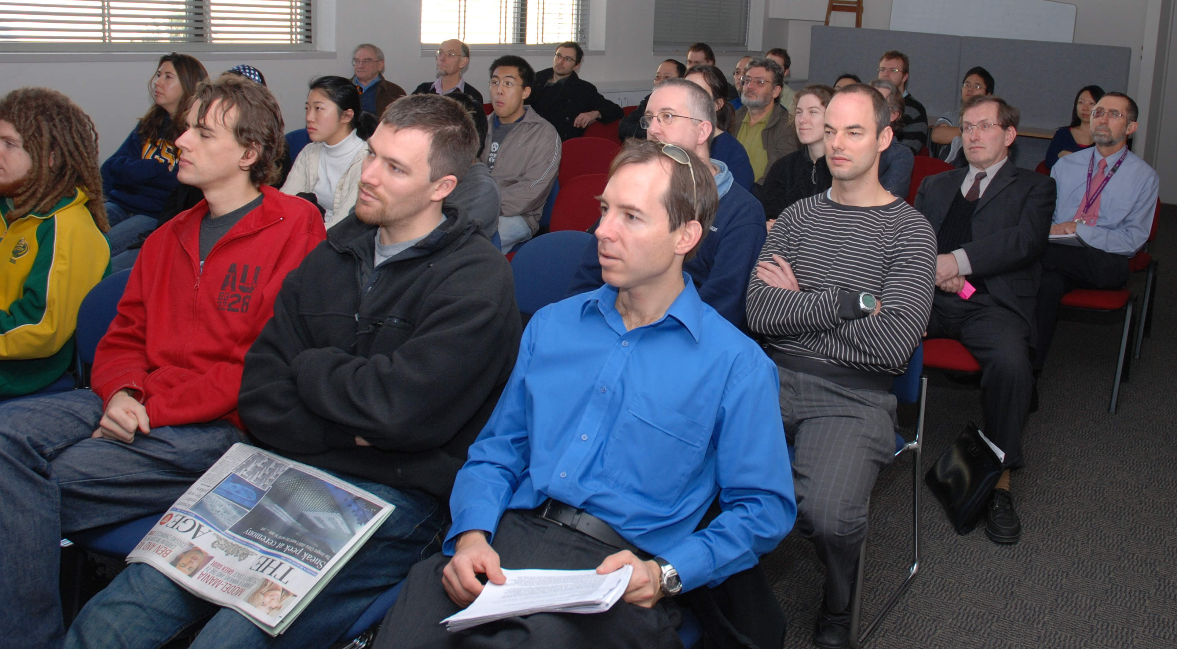
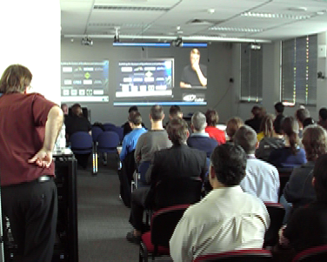
Leveraging HD Video

Slide 8
Conclusions
Our experience with PRIME and PRIUS has convinced us to provide an equivalent experience for our students
This is a pilot program with funding from the DVC (I)
  Need to secure ongoing funding
  In discussion with industry affiliates
Our first year will be 2008/2009 summer
  Wish us luck!

